Slide 1
GROUP 2 PROJECT TITLE: Employee attrition analysis using Exploratory Data Analysis AREA OF INTEREST: HR ANALYTICS TEAM MEMBERS: Ada Anoka, Chinny Akpa, Inyene Bassey, Ayodele Jolayemi, Abiola Adegoke
PROBLEM STATEMENT
In today’s workplace, employee attrition has become an issue of concern as most professionals resign on a regular basis, thereby downsizing firm's employee pool and if not managed, it could pose a threat to an organization’s HR life cycle, its effectiveness and productivity.

Slide 2
EXECUTIVE SUMMARY
Employee Attrition is mainly concerned with the movement of employees from one organization to another; this implies also the hiring of new employees by organizations and dealing with exit of employees (Onuorah & Eze, 2020).
In other words, Attrition is concerned with the rate at which employees exit their job a particular period of time.
This study aims to capture the causes of employee attrition in the workplace using Exploratory Data Analysis and also to help determine factors that could promote employee retention.
OBJECTIVES
To determine the causes of employee attrition in organizations
To assess the effect and factors that will help organizations maximize employee retention
METHODS
Employee Dataset
Dataset collection &business understanding
Data pre-processing
Model selection and training
Exploratory Data Analysis

Slide 3
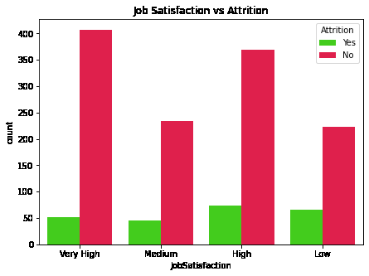
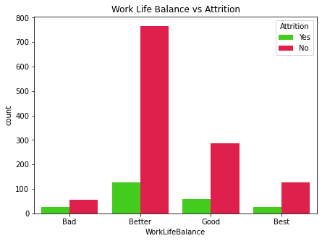
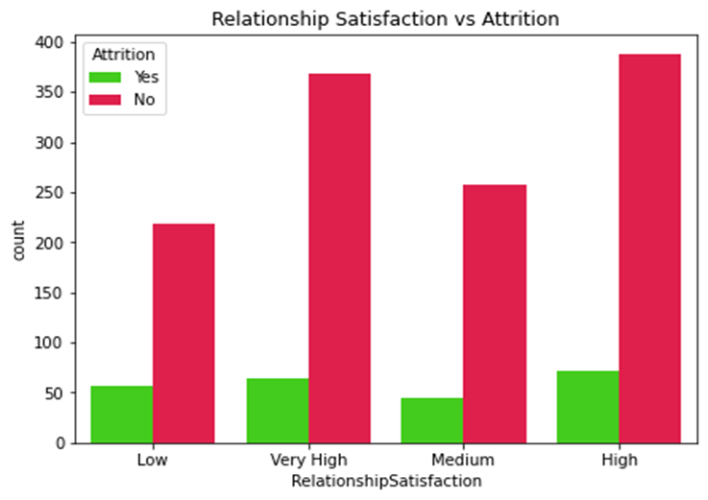
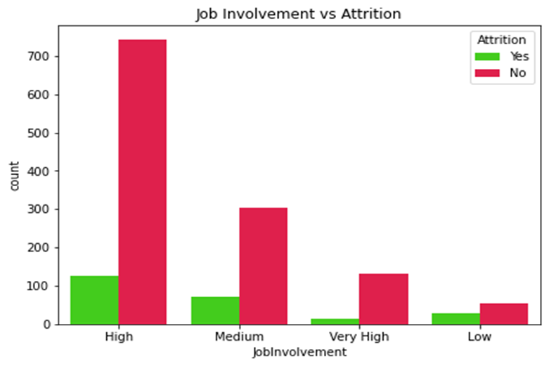

Slide 4
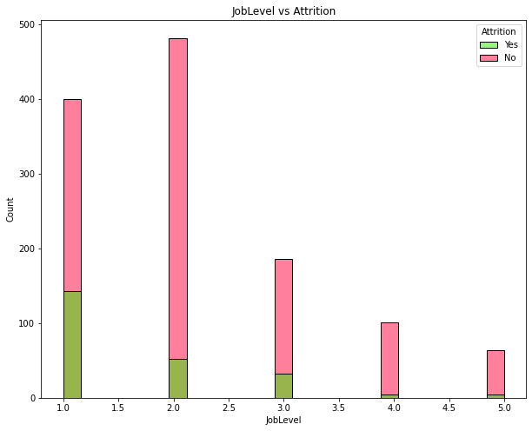
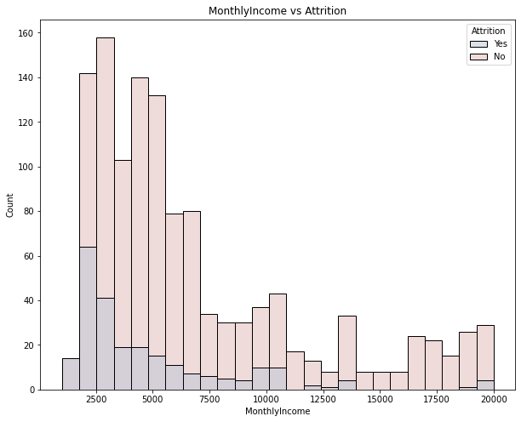
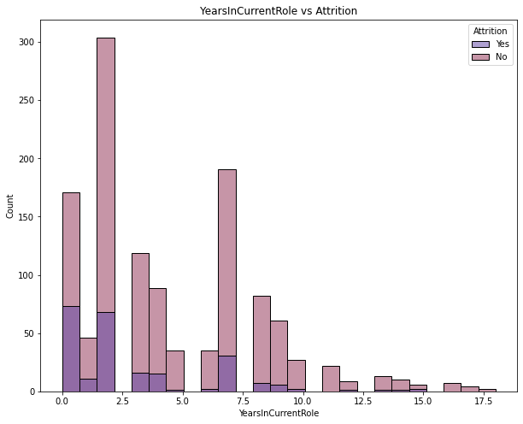
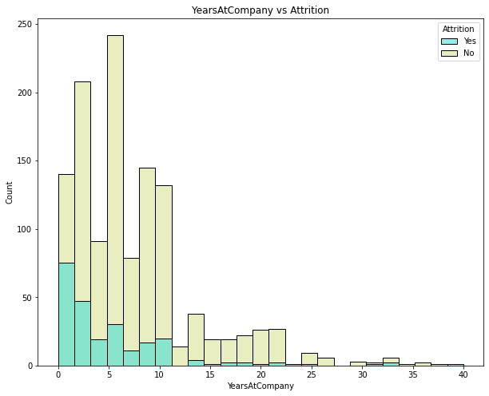

Slide 5
SUMMARY
Results from attrition vs TotalNumberofYears show that the more working years, more years at the company, and more years in current role employees accumulate, the less likely employees are to leave.
For income, the majority of employees who have left were among those with the smaller monthly income varying from 2.000 to 3.000. Those who with less salary hike also tend to leave more than those with a higher precentral hike in salary.
Also, employees who exit their jobs tend to be younger age bracket, with less work experience in the company and at the entry level of their career in general having recorded less 10 years work experience.
It is therefore important to note that employees with less than 2 years work experience with their last manager identified their satisfaction with the work environment as low.
CONCLUSION
Analysis drawn from study show that eleven variables have a significant impact on employee attrition. Furthermore, data gathered shows that an employee with single marital status has more significant number in attrition than those who are divorced and married.
Two factors can drive Employee Attrition, viz; the drive by the employee factor itself and the other is the company factor. Some employees, especially “junior” employees still want to have more experience.
To reduce employee attrition rate, the company needs to improve the human resource department by evaluating the working environment, job satisfaction, employee workload as well as boost interaction between manager and employee.
REFERENCES
Onuorah, A.N. & Eze, S., (2020). “Effect of employee attrition on organizational productivity in Anambra” ... www.researchgate.net. Available at:https://www.researchgate.net/publication/343387316_EFFECT_OF_EMPLOYEE_ATTRITION_ON_ORGANISATIONAL_PRODUCTIVITY_IN_ANAMBRA_STATE_MANUFACTURING_ORGANISATION [Accessed September 8, 2022].
https://www.kaggle.com/datasets/patelprashant/employee-attrition

